Slide 1
Motivation & Emotions

Slide 2
Motivation
Motivation: the factors that direct and energize the behavior of humans and other organisms
A motivation is a driving force that initiates and directs behavior.
Some motivations are biological, such as the motivation for food, water, and sex.
But there are a variety of other personal and social motivations that can influence behavior, including the motivations for social approval and acceptance, the motivation to achieve, and the motivation to take, or to avoid taking, risks.

Slide 3
Cont.
Motivations are often considered in psychology in terms of drives, which are internal states that are activated when the physiological characteristics of the body are out of balance, and goals, which are desired end states that we strive to attain.
Motivation can thus be conceptualized as a series of behavioural responses that lead us to attempt to reduce drives and to attain goals by comparing our current state with a desired end state

Slide 4
The internal thermostat
Like a thermostat on an air conditioner, the body tries to maintain homeostasis, the natural state of the body’s systems, with goals, drives, and arousal in balance.
When a drive or goal is aroused—for instance, when we are hungry—the thermostat turns on and we start to behave in a way that attempts to reduce the drive or meet the goal (in this case to seek food).
As the body works toward the desired end state, the thermostat continues to check whether or not the end state has been reached.

Slide 5
Intrinsic vs Extrinsic Motivation
Intrinsic (arising from internal factors)
Extrinsic (arising from external factors)
Intrinsically motivated behaviors are performed because of the sense of personal satisfaction that they bring
Example: You are in university because you enjoy learning and want to pursue an education to make yourself a more well-rounded individual.
If so, then you are intrinsically motivated.
while extrinsically motivated behaviors are performed in order to receive something from others.
Example: However, if you are here because you want to get a college degree to make yourself more marketable for a high-paying career or to satisfy the demands of your parents, then your motivation is more extrinsic in nature.

Slide 6
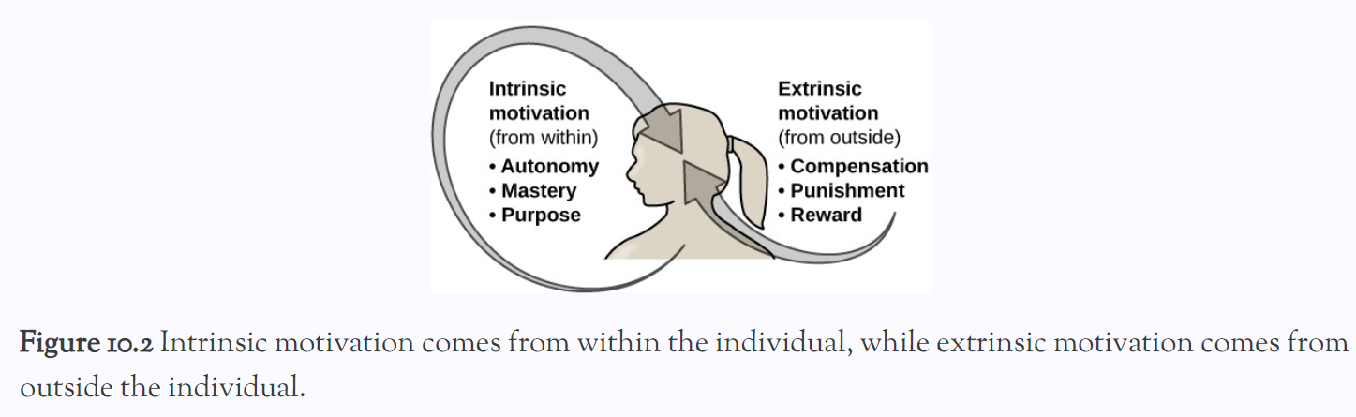
In reality, our motivations are often a mix of both intrinsic and extrinsic factors, but the nature of the mix of these factors might change over time.

Slide 7
Self Efficacy & Motivation
Self-efficacy is an individual’s belief in her own capability to complete a task, which may include a previous successful completion of the exact task or a similar task.
An individual’s sense of self-efficacy plays a pivotal role in motivating behavior (Bandura, 1994)
Motivation derives from expectations that we have about the consequences of our behaviors, and ultimately, it is the appreciation of our capacity to engage in a given behavior that will determine what we do and the future goals that we set for ourselves.
For example, if you have a sincere belief in your ability to achieve at the highest level, you are more likely to take on challenging tasks and to not let setbacks dissuade you from seeing the task through to the end.

Slide 8
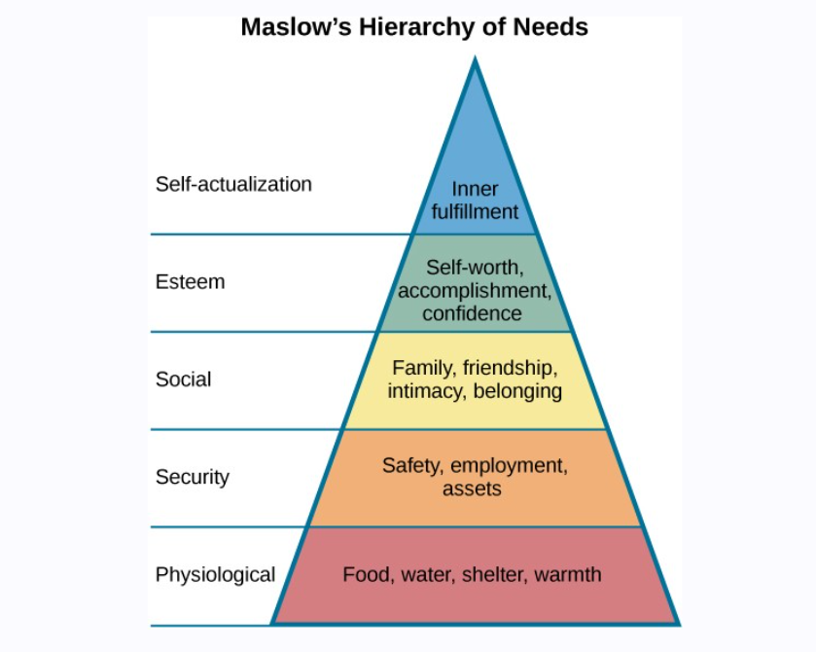
Maslow’s Hierarchy of Needs
Abraham Maslow (1943) proposed a hierarchy of needs that spans the spectrum of motives ranging from the biological to the individual to the social.
These needs are often depicted as a pyramid

Slide 9
Cont.
At the base of the pyramid are all of the physiological needs that are necessary for survival.
These are followed by basic needs for security and safety, the need to be loved and to have a sense of belonging, and the need to have self-worth and confidence.
The top tier of the pyramid is self-actualization, which is a need that essentially equates to achieving one’s full potential, and it can only be realized when needs lower on the pyramid have been met.

Slide 10
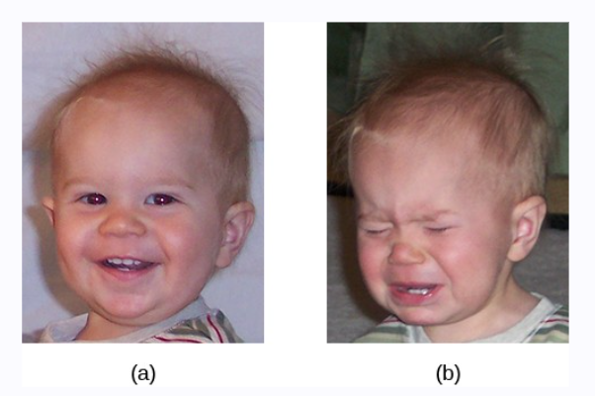
Emotion
An emotion is a subjective state of being that we often describe as our feelings.
Typically, the word emotion indicates a subjective, affective state that is relatively intense and that occurs in response to something we experience
Emotions are often thought to be consciously experienced and intentional.

Slide 11
Components of Emotions
Our emotional states are combinations of:
physiological arousal,
psychological appraisal, and
subjective experiences.
Together, these are known as the components of emotion.
Effected by our culture, experience, & expectations
Everyone experiences differently

Slide 12
Affect - Emotions
Affect, defined as the experience of feeling or emotion.
Affect is an essential part of the study of psychology because it plays such an important role in everyday life.
Importance:
affect guides behaviour,
helps us make decisions, and
has a major impact on our mental and physical health.

Slide 13
James-Lange theory
The James-Lange theory of emotion asserts that emotions arise from physiological arousal.
According to the James-Lange theory of emotion, you would only experience a feeling of fear after this physiological arousal had taken place.
Furthermore, different arousal patterns would be associated with different feelings.

Slide 14
Cannon- Bard theory
According to this view, physiological arousal and emotional experience occur simultaneously, yet independently.
So, when you see the venomous snake, you feel fear at exactly the same time that your body mounts its fight or flight response.
This emotional reaction would be separate and independent of the physiological arousal, even though they co-occur.

Slide 15
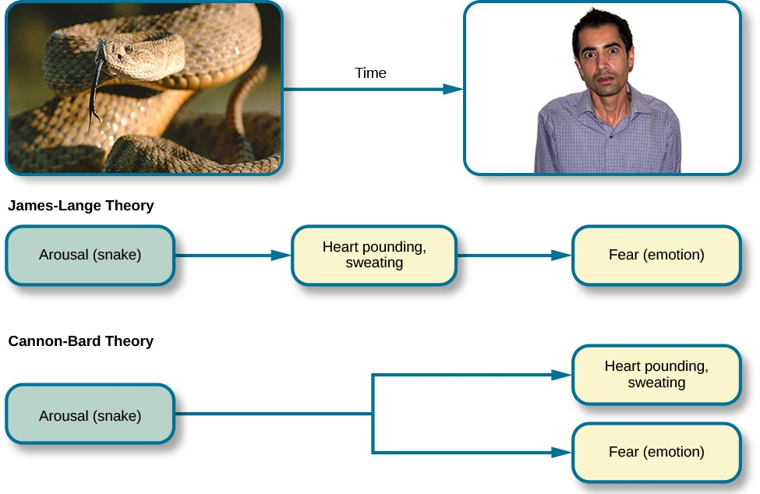

Slide 16
FACIAL EXPRESSION AND RECOGNITION OF EMOTIONS
Culture impacts display of emotions
What expression will be called happiness or what expression will be called sadness etc
Therefore, people from varying cultural backgrounds can have very different cultural display rules of emotion.
For example, research has shown that individuals from the United States express negative emotions like fear, anger, and disgust both alone and in the presence of others, while Japanese individuals only do so while alone
Furthermore, individuals from cultures that tend to emphasize social cohesion are more likely to engage in suppression of emotional reaction so they can evaluate which response is most appropriate in a given context

Slide 17
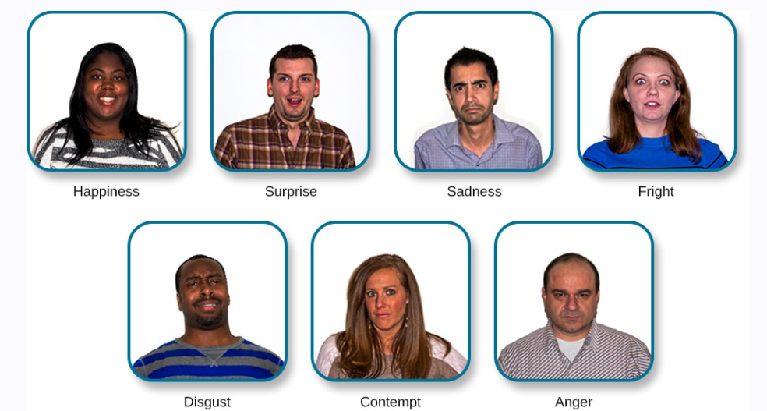
Cultures and gender differences
Difference in expression
Difference in emotional regulation
Some emotional expressions are universal.

Slide 18
Emotions influence motivations & behaviors
Emotions normally serve an adaptive role:
We care for infants because of the love we feel for them,
we avoid making a left turn onto a crowded highway because we fear that a speeding truck may hit us,
and we are particularly nice to Mandy because we are feeling guilty that we did not go to her party.
But emotions may also be destructive, such as when a frustrating experience leads us to lash out at others who do not deserve it.

